Slide 1
Using Solar Energy to Generate Basic Incomes
Robert Stayton
Author of Power Shift: From Fossil Energy To Dynamic Solar Power
Notes:
The theme of this conference is “Bold Ideas, Practical Solutions”, and I think my idea fits those criteria.
I have discovered an exciting, and I think quite feasible, solution to two of the biggest and baddest problems that the world faces.

Slide 2
“The main challenges of our times are the rise in inequality and global warming”
Thomas Piketty, author of Capital in the Twenty-First Century
Notes:
Those two problems are Rising inequality and global warming.
Either of these problems are so serious they could lead to the collapse of modern civilization.

Slide 3
Increase in world temperatures by 2100
Notes:
As you all know, global warming is caused primarily by carbon dioxide released from burning fossil fuels.
Climate models show that unless carbon emissions are drastically cut, we are on track for large temperature increases across the globe, which will:
Raise sea levels and flood coastal areas,
Alter rainfall patterns that agriculture depends on, creating food shortages and mass migrations.
And Drive animal and plant species into extinction.

Slide 4
Paris climate accord ineffective
Notes:
We are not doing enough. The only international treaty in place is the Paris climate accord, which is inadequate.
If we pursue business as usual, we are on track for a 4.2 degree rise by 2100.
If all the pledges for the Paris accord are met, which is doubtful, it will still produce a 3.3 degrees rise,
far more than the goal of 1.5 degrees.
It’s Not enough.

Slide 5
Robots and artificial intelligence threaten jobs
Notes:
At the same time,
Inequality will get worse as regular jobs are replaced by robots, artificial intelligence, and off shoring.
No one knows what jobs will be threatened as AI develops,
But In a nutshell, Machines are cheaper than people, it’s simple economics.

Slide 6
UK survey on basic incomes
Before describing the funding source:
49% responded positively
26% responded negatively
When told taxes would need to be raised:
30% were in favor
40% opposed
Notes:
A universal basic income, the subject of this conference, is seen as a partial solution to this growing inequality.
But getting public support is difficult.
A survey taken in the UK in 2017 shows that most people are in favor of universal basic incomes, before they find out how it is funded. In the survey,
49% responded positively
26% responded negatively
The support flipped when they were told taxes would need to be raised to fund it:
Only 30% in favor
And 40% opposed
What this survey shows is that people think the current economy is unfair, so they support basic incomes.
But taking tax money from working people to give to possibly non-working people is seen as unfair.
As a result, little progress is being made on both of these major world-wide problems,
global warming and inequality, so they continue to get worse.

Slide 7
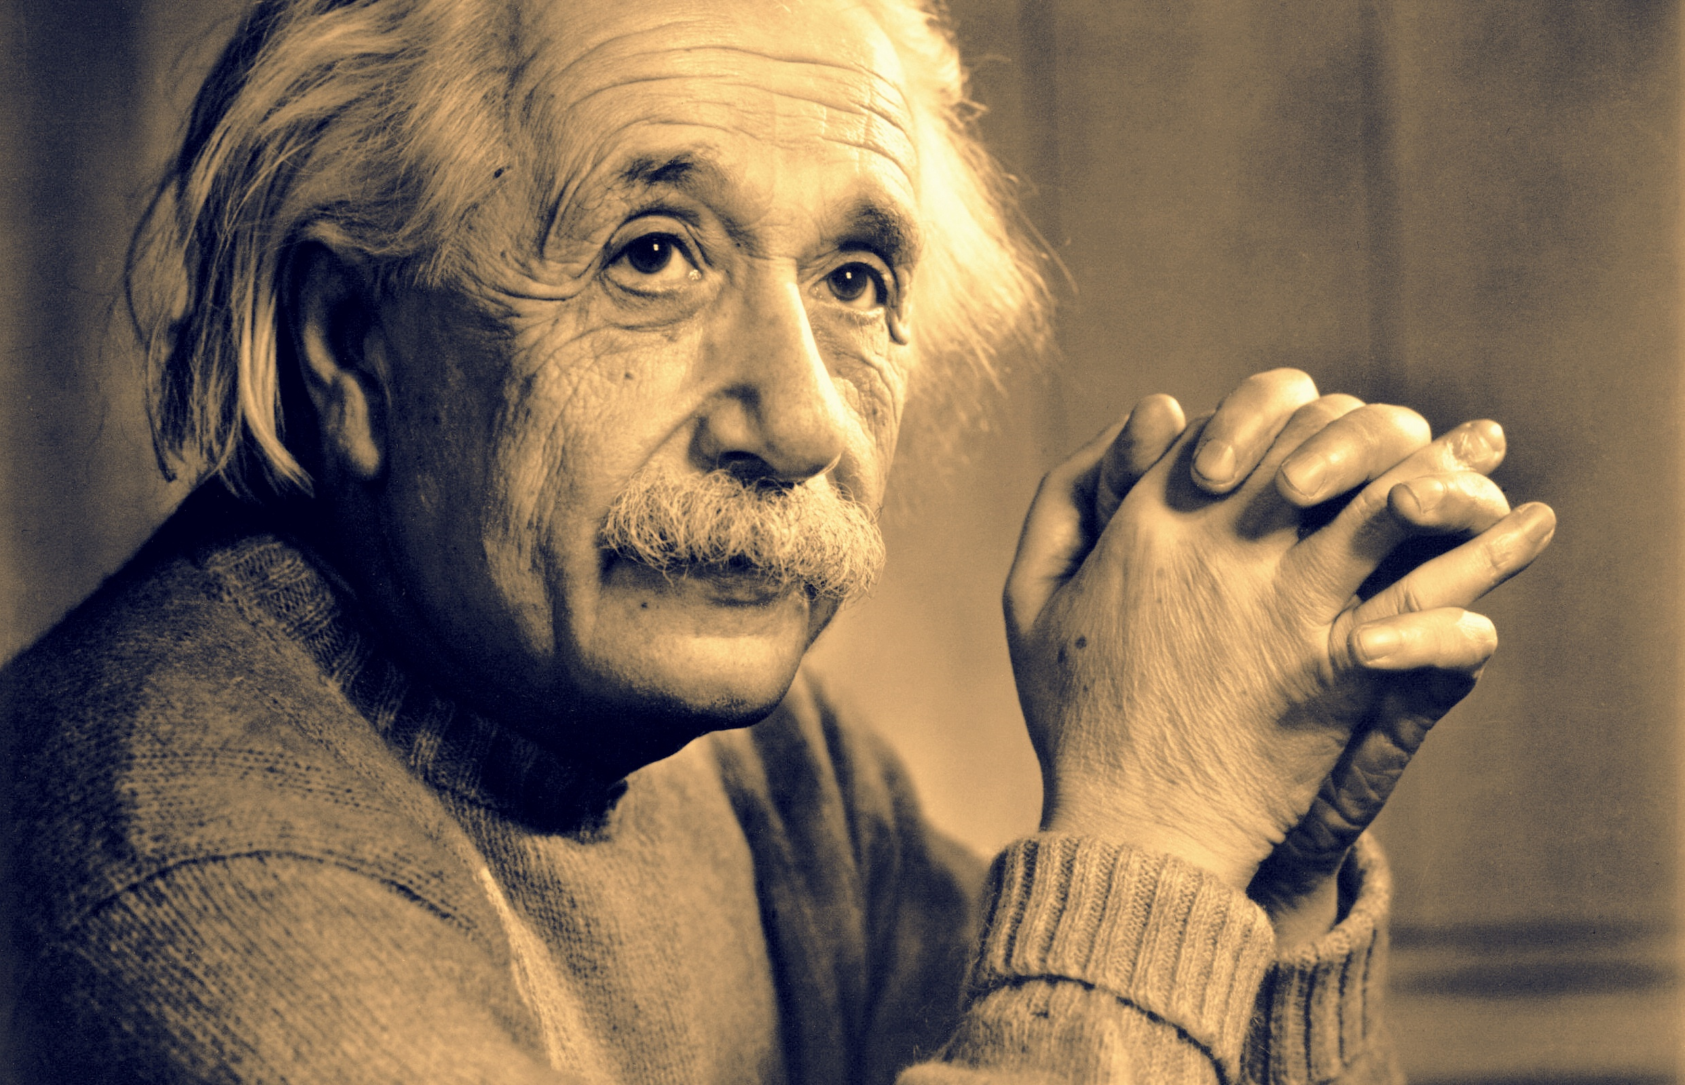
“A new type of thinking is essential if mankind is to survive and move toward higher levels”
Notes:
Einstein wrote in 1946:
“A new type of thinking is essential if mankind is to survive and move toward higher levels”
It turns out that there is a way to fund basic incomes for everyone, and I mean everyone in the world, without taxes,
And address climate change at the same time.

Slide 8
Use solar energy to generate basic incomes
Notes:
My new idea is to use solar energy to generate basic incomes.
The basic idea is to install lots of solar photovoltaic panels, sell the electricity they generate, and use the money to pay for basic incomes.

Slide 9
Solid fundamentals
Solar energy is inexhaustible.
Solar energy is available all over the surface of the earth.
Sunlight hitting a photovoltaic (PV) panel generates electricity.
Electricity is useful, people pay money for it.
Notes:
This idea has solid fundamentals, based on four observations.
Solar energy is inexhaustible. The sun will not run out of energy.
Solar energy is available all over the surface of the earth. Not equally, but available.
Sunlight hitting a photovoltaic (PV) panel generates electricity.
Electricity is useful, so people pay money for it.
So with the right setup, we can use that money for basic incomes.
And the sun is big enough to supply a basic income for everyone.

Slide 10
Basic incomes not from taxes.
Notes:
These are basic incomes that are not based on taxes.
Let that sink in. All those arguments you have to come up with to justify using tax dollars? No longer needed.
We would have an easier time selling basic incomes if they did not come from taxes.

Slide 11
Improve the environment
Reduce global warming.
Reduce ocean acidification.
Reduce air pollution.
Reduce water pollution.
Notes:
And we get a two for one, because we also get improvements to the environment.
By replacing fossil fuels with solar energy, we:
Reduce global warming.
Reduce ocean acidification.
Reduce air pollution.
Reduce water pollution.
We can tackle two major world problems with one program.

Slide 12
Government not required
Notes:
Then it gets even more interesting: because government is not required.
Because the program is not based on taxes,
and because solar is available to everyone,
it need not be run by a government.
That frees up the idea to be implemented in a variety of ways.
I would like to describe one approach that I’ve been developing that captures the imagination of most people I present it to.
It shows how this can be done without government.

Slide 13
10 kW PV for every newborn
Notes:
My idea is to supply a 10 kw PV system to every newborn to generate their basic income.
Let me describe this as a scenario, that takes place some time in the near future.
This is Jamie.
Jamie got a PV system when Jamie was no bigger than a teddy bear.
It started when Jamie’s parents heard about some sort of solar program for newborns.
They contacted the local solar co-op who sent a representative over to their house.

Slide 14
Jamie’s kilowatts on a solar farm
Notes:
Jamie’s kilowatts on a farm, a solar farm.
The member manager from the co-op explained how it worked.
If the parents signed Jamie up as a new member, then the co-op would assign to Jamie a 10 kW section of photovoltaic panels in one of the local solar farms that the co-op managed. A solar farm is an area of land that has a lot of photovoltaic panels installed on it.
The co-op representative explained that the electricity generated by Jamie's 10 kW section of PV would be sold into the grid, and that after the co-op's costs for managing the system were subtracted, the rest of the money would accrue to Jamie as, what they called, Common Solar Dividends.

Slide 15
Generates Common Solar Dividends
“Common” = available to everyone.
“Solar” = generated by solar energy.
“Dividends” = regular monthly payments.
Notes:
The co-op rep explained what that term meant:
“Common” = available to everyone.
“Solar” = generated by solar energy.
“Dividends” = regular monthly payments,
with no work obligation, like dividends from other investments.
The idea is to ensure that everyone has an economic floor on which to stand to keep them out of poverty. If Jamie is unable to find work, or wants to take classes, or do art or social activism, then Jamie would have a base of support.

Slide 16
Who pays for it?
The PV system pays for itself.
The first few years of electricity pay off the cost.
After payoff, income accrues to the member.
Notes:
The parents thought that sounded good, so their first question was “Who pays for it?". The answer that came back was surprising: nothing. The member representative explained that the system would pay for itself. During the first 5 to 10 years of operation, the money generated by the PV panels would pay off the cost of installing it. Only after that period would the income accrue to Jamie.
The rep also mentioned that if the parents or grandparents wanted to pay part or all of the installation costs, then the system payoff date would be earlier and more income would accrue to Jamie.
The parents said they would speak to Jamie’s grandparents, who were retired and had a nest egg, to see if they would be interested in investing part of it now instead of leaving it as an inheritance.

Slide 17
When do dividends begin?
Monthly dividends begin at age 18
Payments do not go to the parents.
Held in escrow until age 18.
Deferred benefits, like Social Security.
Notes:
The parents asked "When would the monthly dividends begin?" The rep explained that once the system was paid off, the money would be held in Jamie's escrow account until Jamie reached the age of 18. The monthly dividends would start after 18, delivered by wire transfer to Jamie’s bank account.
The co-op had learned that sending the money to the parents of the child was not a good idea, because people would start having lots of children in order to accumulate several dividend payments. Although the program starts when Jamie is a child, it is intended to support Jamie as an adult.
The money in the escrow account could be used as a lump sum after age 18 for college tuition, starting a business, or rent deposits.
The parents said "That seems like a long time to wait for any benefits", to which the rep replied "think of it more like Social Security. You pay into Social Security all your life, deferring those benefits until you reach 65. You get the benefits when you need them. Here, the benefits come when Jamie reaches adulthood.
And in the mean time, the world and local community benefits from the solar energy that is generated.

Slide 18
How long do dividends last?
For the life of the member.
Solar panels are replaced as needed by co-op.
Co-op is a long-lived institution.
Notes:
Then they ask “How long do the dividends last?”
For the life of the member.
Although solar panels are long lived, they do wear out, so the co-op replaces them as needed as part of their operating expense.
With replacements, the solar array can last indefinitely.
And the co-op is a long lived institution.

Slide 19
Who owns it?
The member is assigned dividends.
The co-op retains ownership.
No inheritance.
But the dividends follow the member.
Notes:
The parents asked “Does Jamie own the solar panels?”
The rep explained that the member gets dividends from their assigned panels, but the co-op retains ownership.
They cannot be sold or borrowed upon.
And there is no inheritance. When Jamie dies, the panels are reassigned to a new child.
But the dividends follow Jamie, so when Jamie moves away, the dividends still flow to Jamie’s bank account.

Slide 20
How big are the dividends?
That depends on the feed-in tariff.
If 10 cents/kwh, then $1,300 per year.
If 50 cents/kwh, then $6,500 per year.
Notes:
The parents then wondered “How big are the dividends?”
The rep explained that the cost of the PV hardware is known at today’s prices,
And the average amount of sunshine in the area is known, so the average electricity output is known.
The biggest unknown is how much the electricity can sell for, the feed-in tariff.
Here are a couple of examples based on a typical annual electrical output from a 10 kw array.
If the feed-in tariff is 10 cents per kwh, then about $1,300 per year,
Which is comparable to the annual dividends from the Alaska Permanent Fund from oil.
50 cents per kwh is what they got in Germany ten years ago during the highest feed-in tariffs,
And that would produce $6,500 per year.

Slide 21
Solar energy undervalued today
Compared to cheap but dirty fossil fuels
Hidden costs paid by society
High feed-in tariffs worked in Germany and Japan.
Carbon credits increase the value.
Block chain for peer-to-peer transactions.
Notes:
The co-op rep explained that they expect the feed-in tariffs for solar to go up because solar is so undervalued today.
Traditional economics says that solar won’t succeed until it is as cheap as fossil fuels.
But that is a very limited view of the value of solar energy.
Although all electricity is the same when you use it,
It is not the same when you generate it.
Fossil fuels have many hidden costs that are born by society: climate change, pollution, international tensions.
Solar energy has greater value to society, so it should have a higher price.
Germany and Japan set high feed-in tariffs for solar to reflect its value, and their solar industry boomed.
If carbon credits are ever enacted for solar, as is being done in certain parts of the world, that would raise the income.
And new methods of selling solar electricity, besides directly to the reluctant local utility company, are being adopted using block chain technology for peer-to-peer transactions.
These transactions use Solar Coins, which are like Bitcoins.

Slide 22
My child is in the program
She visits her panels.
We teach her about solar energy, and cooperation. She’s only 8, but she gets it.
We buy the carbon credits that her system generates.
Notes:
The co-op rep then said that her child was already in the program.
As a parent, she acts as the proxy member of the co-op until the child reaches 18.
She said her daughter visits the solar farm and sees her panels,
She knows that they generate clean solar electricity which helps the world,
in her name! because her name shows on a plaque mounted to the panels.
She’s only 8, but she gets it.
And we buy the carbon credits that her system generates through the Solar Coin program.
In effect, we are buying our solar electricity from our daughter, which we think is pretty cool.

Slide 23
Why am I doing this?
Our child faces an uncertain future for work because of robotics and artificial intelligence.
And a bleak energy future unless we can turn around climate change.
We want to add a measure of security for our child.
Notes:
Why am I doing this?
We have seen how people are having a hard time finding work in their field because of robotics and artificial intelligence, and fear for the future of work for our daughter.
And we liked the idea of doing solar because our child will be having to cope with a hotter world, and I wanted her to know that we did something.
We are renters, and could not do solar on our own roof, so this program worked for us.
So we hope this action will add a measure of security for our child, at a very low risk to us.

Slide 24
Basic incomes for all from solar energy
Inexhaustible solar energy is available all over the world.
Solar energy can generate economic value.
We can translate that value into basic incomes for everyone.
Notes:
In summary, my idea to generate basic incomes from solar energy can succeed because:
Solar energy is inexhaustible and available all over the planet.
Solar energy can generate economic value through solar panels.
We can translate that value into basic incomes for everyone.
We just need to figure out how to make it work, because it is worth making it work.
What I’m offering is a new way of doing basic incomes
And a new reason for doing solar energy,
And the combination of these two ideas is greater than either one alone. And we can start today.
Thank you.

Slide 25
For more details …
Read my book, for free.
Contact: Robert Stayton bobs@sandstonepublishing.com 831-566-8239
Notes:
I hope this scenario that I’ve described stimulates your thinking about this idea.
There is a lot I could not cover in such a short talk.
I have developed it further in a short book that I will be publishing later this year.
If you would like to get a free copy to review, see me afterward. I would love to hear your comments.
I hope to see this idea developed in lots of different directions. For example, governments could be involved.
There are, no doubt, many approaches, and many problems to be sorted out with each approach.
But I believe this idea has legs.

