Slide 1
Financial Empowerment
A critical complement to basic income
May 25, 2018

Slide 2
Overview
Prosper Canada: Who we are
Tax filing: The ‘Achilles heel’ of basic income?
Basic income: Enough to achieve financial security?
Financial empowerment: What it is and why it matters
How it can work with basic income initiatives to build financial security

Slide 3
Prosper Canada
Founded in 1986, Prosper Canada is a national charity dedicated to expanding economic opportunity for Canadians living in poverty through program and policy innovation.
As Canada’s leading champion of financial empowerment, we work with government, business and community partners to develop and promote financial policies, programs and resources that transform lives and foster the prosperity of all Canadians.
We help service systems and organizations in all sectors to build proven financial empowerment approaches into their businesses in ways that:
Are sustainable
Help them achieve their goals
Tangibly increase the financial well-being of low-income people they serve.

Slide 4
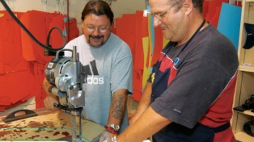
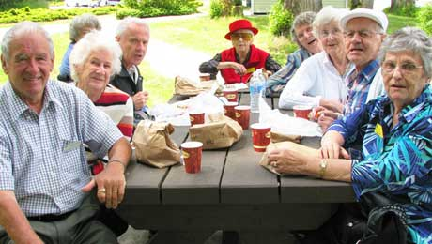
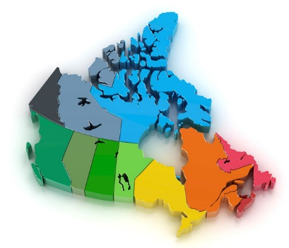
Our vision
All Canadians have access to the financial programs, services, products & advice they need to build their financial wellbeing
Financial information, education, and coaching
to improve financial capability
Help accessing benefits and tax credits
to boost income
Safe and affordable financial products and services
to increase financial inclusion
Saving and asset building opportunities
to build financial security
Consumer protection and education
to reduce financial risk
Notes:
HPW: Changed “that”s to “to”s

Slide 5
Overview
Prosper Canada: Who we are
Tax filing: The ‘Achilles heel’ of basic income?
Basic income: Enough to achieve financial security?
Financial empowerment: What it is and why it matters
How it can work with basic income initiatives to build financial security

Slide 6
Basic income is delivered through the income tax system
…But many people with low incomes don’t tax file because they are unaware of income benefits or experience barriers to tax filing
Benefit | Take-up rate | Missed benefits (millions)
Guaranteed Income Supplement (GIS) | 88%¹ | $255+⁶
Working Income Tax Benefit (WITB) | 85%² | $175⁷
Canada Child Benefit (First Nations - On Reserve) | 79%³ | $108⁸
Disability Tax Credit (DTC) | 40%⁴ | --
Canada Learning Bond (CLB) | 34%⁵ | $900⁹
TOTAL |  | $1,438
Tax filing is the “Achilles heel” of any future basic income program, unless tax filing assistance is available in communities for those who need it
Note: Based on most recent available estimates

Slide 7
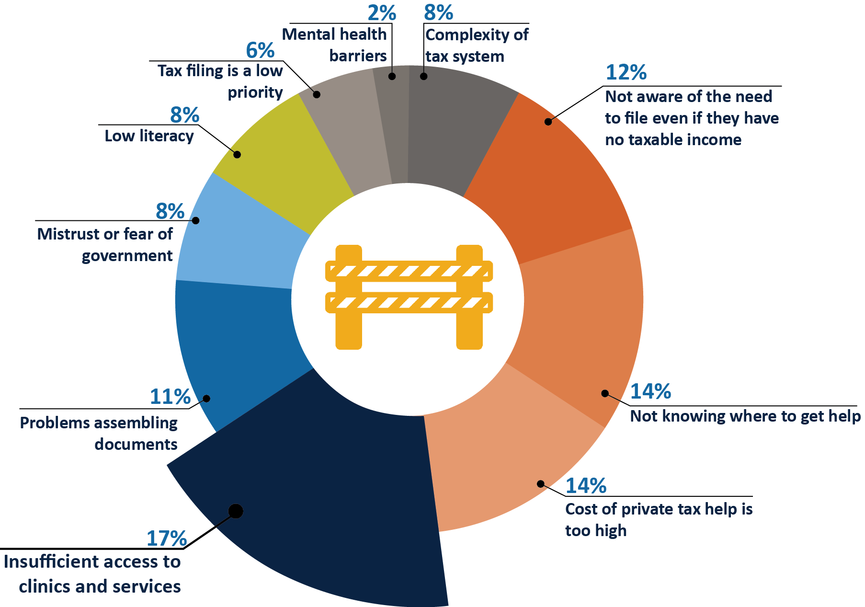
Barriers to tax filing and accessing benefits
Lack of information
+
Poor access to tax filing and benefits help
+
Lack of targeted outreach and supports
Source: 2017 Prosper Canada survey of 300+ community practitioners and experts
http://www.prospercanada.org/getattachment/877cb75f-4f8f-44ff-b762-af726c3afce7/Breaking-down-barriers-to-tax-filing.aspx

Slide 8
Overview
Prosper Canada: Who we are
Tax filing: The ‘Achilles heel’ of basic income?
Basic income: Enough to achieve financial security?
Financial empowerment: What it is and why it matters
How it can work with basic income initiatives to build financial security

Slide 9
Income is a critical – but not the only – determinant of our financial health
Household Financial Security framework
NAVIGATE
the financial system, gather information, and analyze choices to access the right products, make beneficial financial decisions and manage household resources
Financial management skills and owning assets can increase income
LEARN
EARN
SAVE
OWN
the basic skills, executive function, and specific job skills needed to access quality employment
sufficient income (from wages, employer benefits, public benefits, tax credits, etc.) to cover expenses and save
household income left over, after meeting basic needs and paying down debt, for emergencies and the future
a home, business, investments, and/or other assets that build financial security and wealth
PROTECT
household earnings and assets via insurance, consumer protections, and other services and policies
Source: https://prosperitynow.org/household-financial-security-framework

Slide 10
Canadians with low incomes face many additional barriers to achieving financial wellbeing
Barriers
Impact
Low financial literacy
Mainstream financial information, products/services, and advice that are inaccessible or don’t meet their needs
Public policies/programs that impede positive financial behaviours like saving, or fail to incentivize low-income people to the same extent as other Canadians.
Financial options and choices that undermine their future security (e.g. reliance on high cost lenders)
These barriers prevent many low-income people from building the financial stability and assets they need to pursue proven routes to prosperity – education/training, employment, entrepreneurship, and home ownership.
The resulting asset poverty negatively affects families and their housing stability, access to post-secondary education, ability to get and keep jobs or start businesses, and mental health
Lack of emergency savings or access to affordable small dollar credit increases reliance on high cost, high risk lenders, leading to unmanageable debt
Despite this, there are few sources of financial help available.

Slide 11
Currently, no sector is well equipped to address these issues
Frontline government and community service providers rarely have the mandate, knowledge and skills to deal with the causes of financial vulnerability in low-income households such as:
Poor access to neutral and relevant financial information
Difficulty accessing income benefits through tax filing or other programs they are eligible for
Low or nonexistent savings
High debt-to-income levels
Poor credit scores
Reliance on costly/predatory fringe financial services.
Mainstream financial institutions are challenged to deliver effective products/service to low-income people because:
It can be more time consuming (due to lack of required ID, literacy and numeracy issues, low-financial literacy etc.)
They offer fewer short-term, profit generating opportunities
Front-line staff may require additional training (e.g. about income testing, asset restrictions)
Financial products, services and advice designed for middle & high-income clients.
11

Slide 12
Overview
Prosper Canada: Who we are
Tax filing: The ‘Achilles heel’ of basic income?
Basic income: Enough to achieve financial security?
Financial empowerment: What is it and what can it do?
How it can work with basic income initiatives to build financial security

Slide 13
Financial empowerment is a set of interventions that measurably improve financial wellbeing for people with low incomes
Financial Empowerment solution Framework
1. Financial information education and counselling
2. Help accessing government benefits and tax credits
3. Safe and affordable financial products and services
4. Access to savings and asset building opportunities
5. Consumer education and protection
SURVIVAL
These supports help people move from survival to prosperity
PROSPERITY
Crisis | Stabilize | Engage | Build security | Grow assets
Notes:
This framework defines the programmatic and policy territory that we work on to advance our mission. Many of these pillars include programmatic solutions (community level programs and services) but many – like asset building, safe and affordable products, and consumer protection also have an important policy and/or regulatory dimension.
In all cases, polices and program interventions are intended to provide practical help to people with low incomes that enables to move in a positive direction along the spectrum from financial crisis to real opportunity.
In real life, people do not move only in one direction or the other but make progress at some points in their lives and fall back at others in the face of life events like losing their job or getting sick.
People also start from different places along the spectrum.
Our goal is to ensure no matter where they start from, they have access to relevant effective financial empowerment supports in an environment that is conducive to financial inclusion, empowerment and, ultimately, wellbeing.
Our scaling strategy is our plan for how – in the short to medium-term – we can help make this happen. This is based on evidence (particularly from US cities) , what we have learned from our financial literacy and asset building work, and what our frontline partners have told us their clients need.
It also incorporates what we know about the key elements or conditions that need to be in place to achieve the large-scale reach and impact we’re seeking in a sustainable way. These elements include:
Stable adequate funding sources
Knowledge about the financial issues people with low incomes face and effective solutions
Frontline capacity to deliver solutions effectively
Supportive policies and regulations that remove barriers and create opportunity
Collaboration across sectors to make these things happen

Slide 14
Financial empowerment addresses the gap in current social supports aimed at building financial security
FE focuses on strengthening low-income people’s financial inclusion, knowledge, behaviours, and opportunities, unlike many other poverty reduction approaches.
FE solutions enable low-income people to measurably improve their financial outcomes – incomes, credit scores, savings and debt levels.
This, in turn, enhances their access to proven routes out of poverty – education/training, employment, entrepreneurship, asset and home-ownership.
For more information, please see our Financial Empowerment Brief
This provides examples of diverse FE interventions and their impact
http://www.prospercanada.org/ProsperCanada/documents/en/Financial-Empowerment-Brochure.pdf

Slide 15
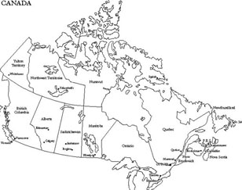
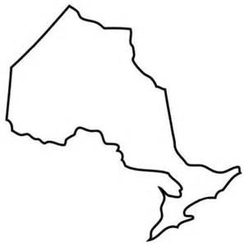
We are piloting solutions with 14 financial empowerment champion organizations across Canada
Through free tax clinics and hands-on benefits assistance, champions have enabled 65,054 Canadians with low incomes to access $128.4M in new income (Jan 2016 to Dec 2018)
CANADA
ONTARIO

Slide 16
Overall impact: 2015 to present
151,234 people with low incomes helped to improve their financial health by Prosper Canada and community partners to date:
65,054 received tax and benefit assistance
$128.4M increase in income
2,384 RESPS opened
46,953 people participated in financial education
23,151 individuals received financial coaching
20,020 people used online financial information, education, and planning tools
318 community financial coaches trained
3,464 community financial educators trained
Benefits to people
New community capacity
January 2015 to March 2018

Slide 17
Overview
Prosper Canada: Who we are
Tax filing: The ‘Achilles heel’ of basic income?
Basic income: Enough to achieve financial security?
Financial empowerment: What is it and what can it do?
How it can work with basic income initiatives to build financial security

Slide 18
Financial empowerment can be a powerful complement to basic income and help ensure all who are eligible participate
Facilitate access to basic income
Increase financial inclusion
Build financial health
Active outreach and promotion
Free tax filing assistance
Hands-on benefit assistance to help people access and retain benefits
Connect people to safe and affordable financial products & services
Consumer protection research, education, and advocacy
Foster financial services innovation to better serve low- income consumers
Neutral, high quality, financial education tailored for diverse groups
One-on-one financial coaching/counselling to help set goals and action plans that improve financial outcomes (credit scores, saving and debt levels)
Help accessing saving and asset building supports (RDSP, CLB and TFSAs)
Achieving this requires investing in community capacity and integration into existing service systems with resources and reach into low income populations (e.g. social assistance, health care, employment, shelters, housing)

Slide 19
To learn more about how Financial Empowerment helps to prevent, mitigate, and reduce poverty
See
ABLE Financial Empowerment Network
2017 policy brief
http://www.prospercanada.org/getattachment/8ff5b01c-ddab-4383-bc47-cdde1a35176f/Financial-Empowerment-What-it-is-and-how-it-helps.aspx

Slide 20
Thank you! Merci! Megwetch!
Prosper Canada
60 St. Clair Avenue East, Suite 700
Toronto, ON M4T 1N5
(416) 665-2828
www.prospercanada.org
Elizabeth Mulholland Adam Fair
Chief Executive Officer VP, Strategy and Impact lmulholland@prospercanada.org afair@prospercanada.org
416 665-2828 Ext. 2229 416 665-28282 Ext.2240

Slide 21
Sources
Sources
Employment and Social Development Canada. Evaluation of the Guaranteed Income Supplement Take-up Measures and Outreach. February 2010. Accessed April 30 2018: https://www.canada.ca/en/employment-social-development/corporate/reports/evaluations/income-2010-february.html
Dean Beeby. “$175M in federal money for working poor goes unclaimed.” CBC News. Posted: Nov 29 2017. Accessed April 30 2018: http://www.cbc.ca/news/politics/working-income-low-poor-canada-revenue-agency-tax-benefits-1.4423280
Canada Revenue Agency. Meeting with Prosper Canada - Key findings from the 2015 tax year. PowerPoint presentation delivered April 30, 2018. Estimates based on use of linkage rates between 2015 tax filing data and 2016 census data as a proxy indicator for tax filing rates. Actual benefit take-up rates are unknown.
Erica Alini. “The CRA makes it so hard to get the disability tax credit, many don’t even try,” Global News. Jan 11, 2018. Accessed Apr 30 2018: https://globalnews.ca/news/3956042/cra-disability-tax-credit-canada/
Employment and Social Development Canada. Canada Education Savings Program Annual Statistical Review 2016. 2017. Accessed Apr 30 2018: https://www.canada.ca/en/employment-social-development/services/student-financial-aid/education-savings/reports/statistical-review-2016.html
Based on estimated 49,100 to 61,900 of eligible seniors who don't receive GIS payments and are non-tax filers according to ESDC 2010 GIS evaluation (above) . Assumes average payment of $432 per month (50% of maximum).

