Slide 1
First Nations Financial Wellness
North American Basic Income Guarantee Congress
May 25, 2018

Slide 2
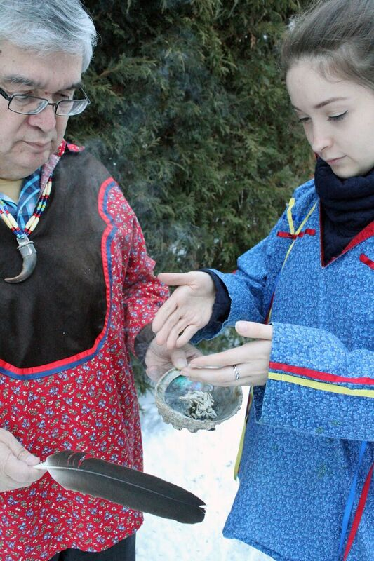
Overview
Who we are: AFOA Canada and Prosper Canada
Financial wellness and its determinants
Opportunities to build financial wellness
What we can do build financial wellness
Resources
All images courtesy of Simon Brascoupé

Slide 3
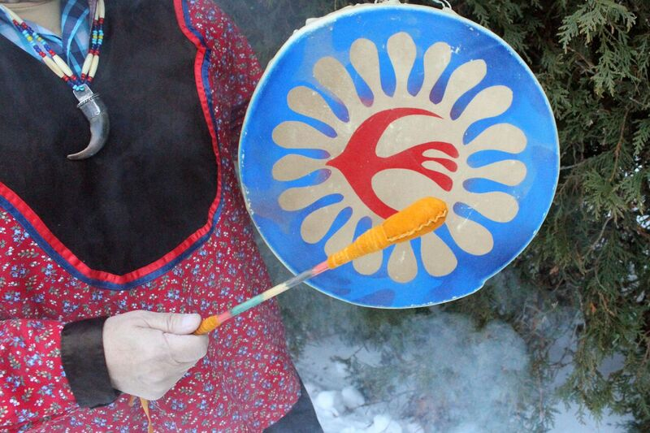
1. Who we are

Slide 4
AFOA Canada
Vision
AFOA Canada is the centre for excellence, information and certification in Aboriginal management
Mission
Building management proficiency and connections that enhance effective Aboriginal governance, administration, and self-reliance.
Education and training programs
Indigenous Financial Literacy and Wellness
Community Capacity Building Workshops
Aboriginal Financial Managers Certification
Aboriginal Professional Administrators Certification
Journal of Aboriginal Management

Slide 5
Prosper Canada
Founded in 1986, Prosper Canada is a national charity dedicated to expanding economic opportunity for Canadians living in poverty through program and policy innovation.
As Canada’s leading champion of financial empowerment, we work with government, business and community partners to develop and promote financial policies, programs and resources that transform lives and foster the prosperity of all Canadians.
We help service systems and organizations in all sectors to build proven financial empowerment approaches into their businesses in ways that:
Are sustainable
Help them achieve their goals
Tangibly increase the financial well-being of low-income people they serve.

Slide 6
2. Financial wellness and its determinants

Slide 7
Financial wellness is understood by Indigenous Peoples to be…
The continuous process of balancing income, saving, investing and spending to achieve one’s life goals (physical, emotional, mental and spiritual) over the life cycle, and to maintain a state of wellness for individuals, family and community.

Slide 8
Indigenous Financial Wellness Framework

Slide 9
4. Opportunities to build financial wellness

Slide 10
First Nations Financial Wellness Project
Building sustainable capacity in communities to provide:
Financial Wellness
1. Education
2. Support
3. Access
Workshops that provide tools and knowledge needed manage money
One-on-one coaching to help people reach their financial goals
Help accessing income benefits, banking services & opportunities to save
Supported by Ontario Trillium Foundation and TD Bank Group
For more information: www.prospercanada.org

Slide 11
Context is different on and off reserve
On reserve
Income not taxable on reserve
Low tax filing rates and income tax preparation is a challenge
No local banks in most cases
ID can be a barrier
Average income low
Education, employment, health indicators significantly below Canadian averages
Urban
Income is taxed
Better access to income tax preparers
More access to banks
ID can still be a barrier
Average income higher than on reserve
Education, employment and health indicators stronger than on-reserve but below Canadian averages

Slide 12
Opportunity: Boost access to income benefits
A significant number of First Nations individuals miss out on important income benefits because they don’t tax file – e.g. $500M in Canada Child Benefits
Barriers
Opportunity
Unaware of benefits
Worried they might owe CRA money
Complexity (tax system and forms)
Low literacy/English language/numeracy
No secure computer access
Difficulty assembling paperwork and I.D
Mistrust of government
Lack of confidence.
Expanding access to benefits is a federal gov’t priority
Rising First Nations awareness and interest – more in the south addressing this issue with tax preparation supports
Prosper Canada and AFOA collaborating to promote opportunity, but local capacity and access to non-profit and gov’t supports can be an issue
We are working to pilot new approaches with CRA volunteer program and others

Slide 13
Opportunity: Build savings
Many Indigenous Peoples are not accessing important government incentive savings programs and benefits such as the Canada Learning Bond (CLB)
Barriers
Opportunity
Few or no local financial institutions
Many people unbanked/underbanked
Low financial literacy
Low income
Precarious/volatile income makes it hard to save
Sharing prioritized over saving
Similar barriers to accessing other government income benefits
Support strategies to building emergency savings to mitigate financial shocks
Financial information, education and one-on-one support can help people save
Help promote and facilitate access to the RESP/CLB.
Innovative tax time savings interventions help people turn tax refunds into emergency/longer term savings.

Slide 14
Opportunity: Expand access to banking services
Only 4 First Nations have a bank on reserve and many communities are forced to rely on informal, high cost and/or predatory financial products and services
Barriers
Opportunity
Few local banks/credit unions
Alternative services costly (Northern Store)
Lack of I.D. an issue for many people
Have to open accounts in person and travel costs can be prohibitive
Poor internet makes online banking hard
Banks interested in serving growing Indigenous market and related partnerships
Fintech may open up secure alternatives to “in person” requirement to open an account
Vouching and services to help people get IDs can reduce this barrier
Federal gov’t expanding high-speed internet to more rural/remote communities

Slide 15
5. What we can do to build financial wellness

Slide 16
Best practices when working with First Nations
Partnership: Work collaboratively. Take the time to develop trust, safety, etc.
Cultural safety: Provide education, support and access that is culturally relevant and safe
Respectful: Build mutual respect, trust and understanding
Knowledge-based: Two-eyed seeing approach uses both Indigenous and western knowledge in finding solutions
Supportive: Support First Nations partners' community interest.

Slide 17
Long-term Focus
Develop tailored financial wellness program models
Develop toolkits and training to support tailored financial wellness program delivery
Build capacity and provide ongoing support to those implementing programs
Supporting communities to integrate financial wellness programs into existing strategies, plans and services
Research, evaluation and knowledge exchange to expand and improve program delivery
Policy and advocacy efforts to improve financial wellness outcomes

Slide 18
Training: Steps and Best Practices to setting up community volunteer tax programs
Prosper Canada and AFOA Canada will be hosting a free 2 part online training in the fall of 2017 to assist First Nation communities and organizations in Ontario on the steps and tools involved in implementing a tax clinic
Dates:
Thursday, Oct 26th 1:00 - 2:30 pm
Wednesday, Dec 6th 1:00 - 2:30 pm
Please complete sign up sheet on to get information to register

Slide 19
Managing your Money booklet and worksheets
A series of seven worksheets to help individuals and families to set and work towards money goals.
Each financial topic and activity paired with a teaching from the animal world
Designed for one-on-one conversations or to be used in financial education workshops
Worksheets are available online

Slide 20
Miigwetch Nia:wen Thanks Merci
Simon Brascoupé Vice President, Education and Training
AFOA Canada
Tel: (613) 722-5543 Ext. 114
Toll-free: (866) 722-AFOA (2362) sbrascoupe@afoa.ca
www.afoa.ca

