Slide 1
The Effects of a UBI on Income Mobility Across the Generations: Case of the US
Jim Bryan
Manhattanville College
Purchase, NY, USA

Slide 2
Should we expand our focus?
Traditional focus: Concern about distribution, here and now.
Not exclusively, of course.
We do talk about beneficial effects on Children, improving the prospects for their futures, in general terms.
But, there has been relatively little attempt to examine the ability of a UBI to improve “upward mobility.”

Slide 3
Absolute Income Mobility (US) since 1940 * Raj Chetty et al, The Fading American Dream, 2016
Def: percent of children who earn more than their parents (at similar ages)
Children born in 1940: 90%
Children born in the 1980’s: 50%
=> Not only have Middle Class wages stagnated, the rate at which the Poor reach the Middle Class has slowed substantially.

Slide 4
The traditional economist’s perspective about governmental efforts to reduce inequality (from 1975)

Slide 5
Why talk about a TRADEOFF?
WORK DISINCENTIVES: sometimes severe
For RECIPIENTS of the Redistribution
For FUNDERS of the Redistribution
This part of the story suggests =>
GREATER EQUALITY always comes at the COST of EFFICIENCY

Slide 6
BUT…….how about the GATSBY CURVE
Named and popularized by the late Alan Krueger.
Is it possible that MORE EQUALITY NOW => MORE MOBILITY LATER???
Is this a fluke correlation – rather than causation? Can redistribution now cause upward mobility over the coming generation?

Slide 7
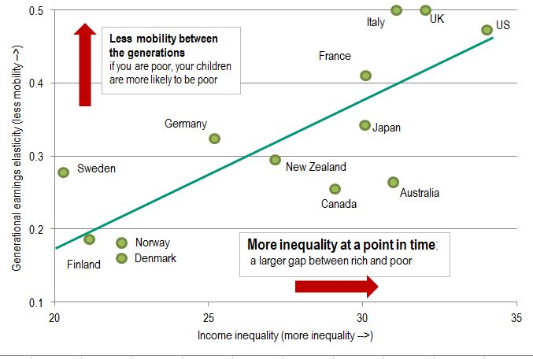

Slide 8
BUT…….Can CASH TRANSFERS NOW improve prospects for current children when they’re adults, LATER???
DESPITE the facts that a UBI may do little:
to change the INEQUALITY of EDUCATIONAL OPPORTUNITIES?
to change a very UNEQUAL GEOGRAPHY of OPPORTUNITY?
to reduce the RACISM that LIMITS OPPORTUNITIES?
to change other POVERTY TRAPS?

Slide 9
If true…
This could explode the presumed tradeoff.
Especially, if done via a UBI, that itself possesses far fewer work disincentives.
We could add the MOBILITY OF OUR CHILDREN to the arguments in favor of a UBI.

Slide 10
What is the evidence in the U.S?
Lessons from our history with:
The Earned Income Tax Credit
“Tax Expenditures” – especially when combined with a more progressive tax (at the state level)
The Food Stamp Program
Different income growth rates for different segments of the US population

Slide 11
Mobility….
difficult to deduce its determinants.
Requires longitudinal data.
Determinants are often inferred from international comparisons, using highly aggregated and messy data.

Slide 12
There are studies focused on the US that:
Show MOBILITY VARIES SIGNIFICANTLY across the US
Are able to gather comparable data on enough variables to estimate some of the determinants of mobility.
Are able to incorporate data on cash and non-cash redistributions.

Slide 13
EITC – Earned Income Tax Credit
Chetty et al (2013)
Significant impact on Mobility, controlling for income segregation by geography
Bastian et al (2018)
Effects on eventual income of children, rates of employment and the extent of their education (high school & college)
Isolated to children in the household in the age range: 13 – 18 yrs
Baughman (2009)
Little evidence that EITC affects fertility rates

Slide 14
Food Stamps
Hoynes et al (2016)
Participation of families has the following effects:
Increased future earnings of children
Increased education of children
Reduced incidence of metabolic syndrome
“The younger the initial age of exposure the larger the (cumulative) effect of the FSP.”

Slide 15
Can Food Stamps be compared with Cash?
Hoynes and Schanzenbach (2009):
Show that food stamps have almost the same effects as an income transfer of equal size.

Slide 16
Mothers’ Pension Program (1911-1935)
Aizer et al (2016)
Chose this program since it predates other programs that could produce confounding effects.
Do CASH TRANSFERS provide life-long benefits for children in the recipient families?
Focus on Poor Families: Income eligibility requirements

Slide 17
Mothers’ Pension Program (cont)
Reasons cash transfer might not have long-term benefits for the children:
Parents might not increase their spending on their children.
The transfers might be too small to do much good.
Parents might not be well informed about the efficacy of their different spending options.

Slide 18
Mothers’ Pension Program (cont)
Long-Term Benefits:
Increased income in early adulthood: 14%
Increased educational attainment: 0.34 years
Reduced the probability of being underweight: 50%
Increased life expectancy: 1 year (1.5 yrs for the poorest)
All this for a program that:
Increased household income 12%-15%
Had a median duration: 3 years
Focused on single-mother headed households

Slide 19
Role of Aggregate Economic Growth (the source of most household income)
Chetty et al (2016)
The decline in the rate of growth in GDP can explain part of the decline in absolute income mobility.
HOWEVER, “…changing the distribution of growth across income groups to the more equal distribution experienced by the 1940 birth cohort would reverse more than 70% of the decline in mobility.”

Slide 20
And Finally…about the Distribution of Children
 | DISTRIBUTION OF CHILDREN OVER INCOME
 | Lowest | Second | Middle | Fourth | Top
 | Quintile | Quintile | Quintile | Quintile | Quintile
1979 | 24.4% | 22.4% | 22.2% | 18.5% | 12.0%
1990 | 28.2% | 21.5% | 20.6% | 17.0% | 12.2%
2000 | 27.1% | 21.8% | 19.6% | 16.9% | 14.2%
2010 | 28.0% | 21.5% | 18.5% | 16.7% | 14.9%
2015 | 28.6% | 21.5% | 18.3% | 16.2% | 15.1%

Slide 21
In sum….
Mobility is important and is getting worse.
A Basic Income has the capacity to improve not only the current Income Distribution but also the Mobility of current children as they go through adulthood.
Especially given the current Distribution of Children over Household Income, since the UBI conveys benefits per person. It is child-oriented and opportunity-oriented by nature.

